Slide 1
SERVICES & SOLUTIONS
Digital Transformation
Digital Optimization -slide 6
Digital Sales
Data Masking Solution
IT Cost Optimization
Web Presence optimization
Enterprise Application Services
Software Development
Application Management
Application Services
Cloud & DevOps
Cloud Services
IT Infrastructure
Digital Security
DevOps
Data & Automation
Data and AI
Intelligent Automation

Slide 2

"AI-Powered Innovations, Redefining Possibilities"

Slide 3

Generative AI Solutions and Services Tailored for Every Industry
From cutting-edge use cases to tangible outcomes, Nextech designs GenAI solutions customized to meet your unique business needs.
Talk to our GenAI Expert
Notes:
Link to Data & AI page

Slide 4

We excel in creating advanced data analytics and AI solutions
Overcome data challenges and harness the power of intelligent automation. Enable confident decision-making with precise data, advanced AI, and actionable insights.
Talk to our GenAI Expert

Slide 5

Transforming your digital landscape
Nextech Enterprise, specializes in cutting-edge IT solutions tailored to meet your unique business needs. We harness the power of Generative AI, Data & Analytics, Intelligent Automation, and Enterprise Security to elevate your operations. Our expertise in Software Application Development and Cloud Infrastructure ensures that your organization stays ahead in today’s competitive landscape. Partner with us to drive innovation and efficiency in your digital transformation journey.
Get in touch

Slide 6
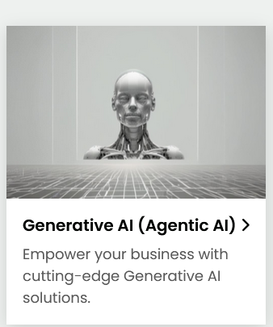
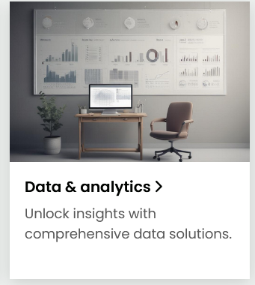

Empowering your business with technology
Learn More
Learn More
Learn More

Slide 7

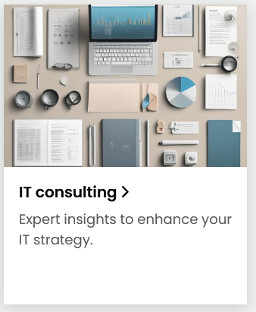


Slide 8

Digital Optimization page
Accelerated Digital Enablement
In today’s fast-paced world, robust digital capabilities are essential.
Swiftly launch new digital sales channels, optimize eCommerce and delivery performance, expand capacity with agility, and elevate the digital experiences you provide to your customers.

Slide 9
The digital solutions you've been waiting for, delivered faster
Our rapid deployment services are thoughtfully crafted for swift execution and implementation. They address critical improvements that demand immediate action, bypassing the delays often associated with traditional hiring processes
Quickly establish new digital sales channels
Accelerate enhancements to eCommerce platforms
Boost digital delivery capacity significantly
Scale operations rapidly and efficiently
Continuously refine and improve the user experience
Introduce new channels and features that resonate with customers
Connect with out Digital Enablement Team

Slide 10


Nextech Offerings for Accelerated Digital Enablement
Built for swift impact, our teams focus on addressing critical needs to optimize and elevate the performance of your current digital systems without delay.
Quickly resolve issues with unstable or overloaded platforms or channels
Digital Commerce Solutions: Swift setup of fully operational temporary digital channels to mitigate instability or handle saturation effectively.
Tailored eCommerce Platform Support: Fast-track stabilization and optimization of existing eCommerce systems to prevent sales interruptions during demand surges, while laying the groundwork for a sustainable long-term strategy.
Accelerate or transform your digital delivery approach
Seamless Integration of Delivery Channels: Quickly connect to digital platforms to establish new or temporary delivery methods, ensuring continuity even when core channels face disruptions.
Enhanced Digital Front-End Support: Analyze customer behavior, pinpoint areas for improvement, and resolve issues to elevate the overall user experience.
AI-Driven eCommerce Testing: Deploy intelligent testing scenarios for eCommerce platforms, leveraging AI and cognitive tools for swift and efficient evaluations.

Slide 11

Achieve Best-in-Class eCommerce at Unmatched Speed
Enterprise-Ready Commerce Solutions: Deploy omni-channel, enterprise-grade digital commerce and CRM platforms seamlessly and efficiently.
eCommerce On-Demand – Performance-Based Model: Go live with Hybris or Magento eCommerce solutions in under two weeks. Our expert digital marketing teams drive customer acquisition and sales, while you benefit from a transaction-based model that lets you retain 100% of the profits.
Comprehensive Marketing Support: Our in-house digital marketing experts collaborate closely with our rapid deployment teams to create tailored demand generation strategies that fuel eCommerce growth and maximize sales.

Slide 12

Digital Sales Services Page
Digital Sales Services
Does your digital commerce meet the high expectations of both your customers and shareholders?
By leveraging our expertise, innovative solution accelerators, and strategic partnerships, we empower you to enhance customer engagement and drive exceptional performance in your digital commerce operations.

Slide 13
Transform your digital commerce to deliver an exceptional customer experience.
Providing a seamless and engaging online shopping journey can have a profound effect on your customers. Attention to every detail, from SEO strategies to reliable delivery, is essential.
Is your e-commerce platform overly tailored, making it cumbersome to manage?
Are your logistics processes optimized to boost customer satisfaction?
Do you need innovative strategies to attract new customers and drive sales growth?
Is your platform proving costly to maintain or customize?
Are you struggling with the resources and expertise required to manage and enhance your digital commerce solution?
Connect with out Retail Sales Team
Our Value Proposition
Quickly unlock new digital sales channels with Nextech’s flexible, end-to-end solutions, powered by advanced accelerators and seamless integrations with leading retail software platforms. Spanning the entire digital commerce lifecycle—from demand generation and eCommerce platforms to backend logistics, last-mile delivery, payment systems, and analytics—our solutions enable you to transform into a cutting-edge Digital Commerce powerhouse with speed and efficiency.

Slide 14


Nextech Value proposition
Growth Marketing
The customer journey starts with driving traffic and maximizing conversion rates—key factors for achieving success.
Staying ahead of the curve requires leveraging effective advertising on platforms like Google, Facebook, and Instagram. Our digital marketing expertise ensures we guide you through the entire process, connecting your brand with the right audience and making it easier for customers to discover you.
eCommerce Solutions Tailored to Your Business Needs
As businesses evolve, existing eCommerce platforms often struggle to keep up with growing demands and the need for advanced customization.
With extensive expertise, skilled professionals, and strong partnerships, we specialize in quickly deploying or enhancing comprehensive eCommerce platforms. In collaboration with retailers, we identify the ideal technology and features to create a seamless and engaging buying experience—delivering results in as little as two weeks.

Slide 15

Supply chain
Optimize logistics operations to stay ahead of product demand and elevate customer satisfaction.
With the surge in digital transactions, many retailers face challenges in meeting customer needs effectively. Real-time visibility into key business metrics is essential for driving operational efficiency. Nextech enables you to centralize processes, empowering you to make informed decisions that enhance performance and reduce inefficiencies.

Slide 16
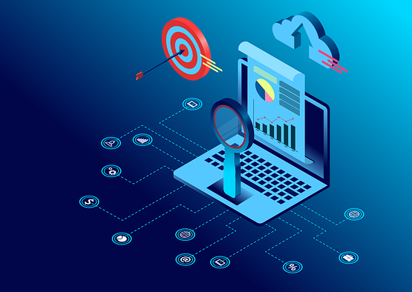
Data Masking Solution page
The Ultimate Solution for Secure, Flexible, and Efficient Data Masking
In the face of escalating data volumes, stringent regulations for personal information protection, and the critical need for testing with real data, businesses face mounting challenges. Protecting sensitive data belonging to companies, clients, and partners while mitigating the risk of costly penalties requires decisive measures. Our solution ensures the secure and confidential management of personal information, providing the confidence needed to meet regulatory demands and operational needs

Slide 17
Safeguard Personal Data and Stay Compliant
Minimize the risk of data breaches or leaks.
Maintain full compliance with data protection regulations.
Continuously monitor and enhance information security measures.
Safeguard data quality in testing environments.
Handle support incidents securely and efficiently.
NextGen leverages advanced expertise and a proven approach to securely manage sensitive information without compromising its integrity. Using cutting-edge data masking techniques, we protect data during testing, customer support, analysis, reporting, and other critical processes.
Talk to Our expert

Slide 18




What’s behind NextGen?
Effortlessly implement a targeted solution for safeguarding sensitive data. Ensure the protection of your business and client information by creating realistic, valid data for use in non-production environments such as development, testing, training, and quality assurance. We empower you to quickly transition to a more agile and secure data masking approach.
Stream Line
Real Data
Integrity
Monitoring
Efficiently streamline data volumes in test environments, reducing maintenance costs and minimizing the resources needed for setup and management
Generate realistic data to enhance the quality of testing and development environments. Our solution includes a powerful tool that detects sensitive fields and applies masking to ensure data security and accuracy
Assists in identifying and applying integrity constraints that are not explicitly define within the data model.
Simplified configuration, monitoring, and management of masking processes through a centralized administration module, complete with comprehensive reporting for monitoring and auditing purposes.
Let’sTalk

Slide 19

IT Cost Optimization page
Optimize IT Functions and Spending to Drive Innovation
Nextech partners with technology organizations to streamline their technology spending, unlock funds for critical innovations, and maximize the value of IT investments. We achieve this without compromising essential capabilities or the quality of services delivered

Slide 20
Reassessing business priorities often reveals redundant efforts.
DevOps practices enhance productivity and reduce rework significantly.
RPA and AI drive substantial efficiency gains.
Conducting root cause analysis can sustainably reduce support demands.
Licenses, user seats, and hardware are frequently underutilized.
Continuous improvement initiatives help prevent waste accumulation.
Aligning tasks with skill levels often optimizes talent utilization.
Data centers can be streamlined as cloud migration progresses.
Hidden costs often stem from unreliable applications
Effective practices and processes to streamline IT, boost productivity, and enhance responsiveness.
IT cost optimization strategies provide a comprehensive review of all avenues to achieve a leaner, more digital, and modern organization while preserving essential business and technology capabilities.

Slide 21

Nextech IT Optimization offerings and domains
Reduce the costs of developing and delivering applications and digital solutions, from concept to deployment.
Rationalize enterprise application licensing and support costs
As businesses embrace digitization, applications and digital platforms become integral to operations, often accounting for an increasing share of overall spending. Streamlining the application portfolio by consolidating redundancies, retiring unused or low-value applications, and reducing support and maintenance costs can free up resources for strategic software and high-impact projects.
ERP Consolidation Services
Simplifying the technology ecosystem
Application Maintenance and Support
Optimization of Software Licensing Costs

Slide 22

Enhance the efficiency and agility of IT operations
Day-to-day IT operations can quickly become costly, often consuming over 60% of the budget. By introducing IT productivity enhancement programs, organizations can achieve substantial savings across various functions while redirecting talent toward strategic initiatives. Building an intelligent IT operations framework provides ongoing real-time insights and advanced automation, reducing support costs and significantly optimizing operational performance
Enhancing Productivity in IT Operations
Smart IT Operations

Slide 23

Transition to the cloud and maximize resource efficiency.
Transition to the cloud to enhance IT infrastructure availability, scalability, and flexibility. Optimize total cost of ownership by carefully selecting, designing, migrating, orchestrating, and fine-tuning computing and storage resources across public, private, and hybrid cloud environments.
Cloud Migration and Transformation Pathway
Cloud Management and Optimization
Embracing the Cloud

Slide 24

Application Services page
Software Development Services
Accelerate time to market, reduce development costs, and enhance code quality.

Slide 25

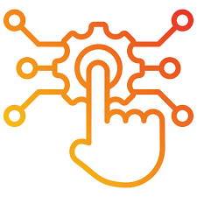
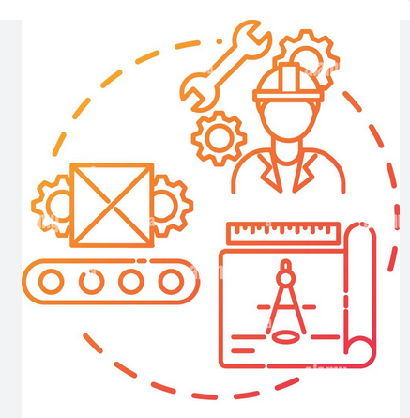
Nextech Offerings
Application transformation
Enhance, upgrade, or resolve issues within an application or portfolio by leveraging modern technologies and implementing a refreshed user experience.
Digital solutions development
Develop cutting-edge digital solutions powered by AI, machine learning, digital experience platforms (DXP), enterprise IoT, business process management systems (BPM), and more.
Continuous product engineering & operation
An all-in-one service package combining integrated teams for feature development, All level support, SRE, Backed operations.

Slide 26

Application Management
Ongoing application maturity ensures sustained value.
As customer needs evolve, business applications must adapt quickly. Nextech’s application management approach enables swift application evolution while maintaining seamless and reliable performance.

Slide 27
Real-time transparency in application
management
Our application management framework is adaptable and designed to accelerate progress across various industries.
Elevate application maturity with a comprehensive 360-degree perspective, enabling seamless support for core business operations and unlocking business value.
Leverage intelligent automation to enhance user empowerment, boost engagement, execute routine tasks with precision, and foster continuous improvement.
Strengthen your distributed agile teams with skilled nearshore remote talent.
Establish a robust foundation with Nextech's governance platform, enhanced by ServiceNow and other leading ITOM solutions.
Align application management services with Lean-Agile methodologies and DevOps principles for maximum efficiency and innovation.
The transition to agile and DevOps has ushered in an era where applications are continuously evolving. With the widespread adoption of cloud-based solutions driven by APIs, your systems are now deeply interconnected with those of others. This makes ensuring seamless operations more essential—and more complex—than ever before.
Nextech’s innovative, next-generation Application Management Services (AMS) approach is designed to meet the demands of modern digital business operations. Trusted by some of the world’s most advanced IT ecosystems, our model is tailored to meet the unique needs of various industries, including retail, manufacturing, consumer goods, banking, insurance, travel, and hospitality.

Slide 28


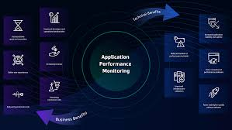

Application Management Offerings
Next Gen AMS Consulting
Application Modernization
Application Monitoring
Application Cybersecurity
From evaluating existing AMS processes, applications, and workflows to crafting a roadmap for modernizing AMS into a seamless, cutting-edge operation, we create a robust foundation designed to adapt to ever-changing business demands and technology advancements—and bring it to life for you.
Implement robust security practices and functions to ensure secure code, infrastructure, and operations. Our service seamlessly integrates with true DevSecOps models, enhancing application security while continuously monitoring daily activities to identify anomalies and potential threats, including ransomware and other emerging risks.
Our approach leverages the strengths of your application portfolio, seamlessly integrating it into a modern, cloud-based digital foundation that is dependable, efficient, and cost-effective to manage.
We move beyond traditional application dashboards by mapping the entire application portfolio and aligning it with critical business processes. Incorporating infrastructure dependencies, we establish a foundation for operational intelligence. This approach delivers real-time insights from business, functional, and application viewpoints, significantly enhancing performance and minimizing operational disruptions.

Slide 29

Application Service
Build your digital success on a dependable application foundation.
Business need evolve rapidly and unpredictably. Staying ahead mean having a software portfolio that’s flexible and adaptable, enabling you to transform challenges and opportunities into innovative digital solutions

Slide 30
Business needs are constantly changing and often unpredictable. Staying ahead requires a software portfolio that is both agile and adaptable, allowing you to turn challenges and opportunities into cutting-edge digital solutions.
In the journey toward enterprise transformation, ensuring your applications align with your digital ambitions is critical. Applications that work seamlessly together empower your teams, partners, customers, and supply chain. However, rapid innovation often brings unpredictable business demands, requiring a software portfolio that is both flexible and adaptable.
At Nextech, we are driven to redefine software engineering by mastering complex backends while delivering innovative, customer-focused experiences and software solutions. Our mission is to enhance customer satisfaction, reduce operational costs, and mitigate risks in complex operations.
Over 100 software engineers strategically located
Agile engineering practices led by certified SAFe leaders
Advanced network of 20+ Centers of Excellence specializing in modern software foundations, including DevOps, APIs, CX, AI, Quality Engineering, and Cloud
Expertise in modernizing complex legacy systems
Industry-specific accelerators designed to deliver rapid business outcomes

Slide 31


Essential Platform Services
We provide comprehensive Databricks services to help organizations harness the power of data and AI. From building scalable data pipelines to enabling advanced analytics and machine learning, our expertise ensures seamless integration and optimized performance. Empower your business with faster insights and data-driven decision-making.
With a team of hundreds of Salesforce experts, we offer comprehensive services to accelerate sales, boost revenue, and maximize the potential of the world’s leading CRM platform. Our end-to-end solutions include implementation, customization, application development, integration, and ongoing support.
We drive digital transformation by leveraging Microsoft platforms and technologies such as Azure, CRM, BI, Office 365, and development tools. Our approach helps you gain a competitive edge, unlock new business opportunities, and prepare for the future..
Learn More
Learn More
Learn More

Slide 32


Nextech delivers comprehensive ServiceNow services, covering consulting, implementation, development, and full-scale intelligent IT operations transformation.
With ServiceNow, we empower businesses to create intuitive, self-service experiences, delivering what customers need while reducing costs and enhancing operational efficiency.
Nextech offers expert New Relic services to help businesses achieve full-stack observability and optimize application performance. From implementation and integration to advanced monitoring and analytics, we ensure your systems deliver seamless user experiences, improve reliability, and drive operational efficiency. Unlock the power of real-time insights with New Relic.
Learn More

Slide 33


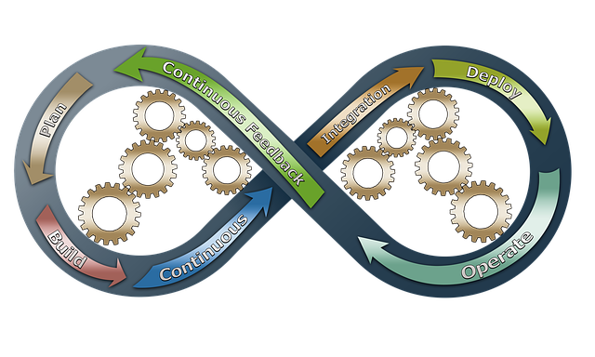
Core Application services and practices
This is link to software development part
Slide 22
This is link to software development part
Slide 24
Software Development
Application Management
DevOps
We collaborate with Product Owners managing ambitious roadmaps within tight budgets. Backed by over 10,000 software engineers and expertise across platforms, our product-focused approach combines solution accelerators, automation platforms, and low-code/no-code capabilities to balance time-to-market demands, budget limitations, and stringent quality standards
Achieve real-time visibility and make quicker business decisions with Business-Driven AMS. Connect applications and infrastructure to key KPIs, ensuring seamless business operations, and link every task to the success of daily digital and physical workflows.
Achieve “Continuous Everything” by implementing automated processes for software configuration management, regression testing, cloud, and software-defined environments. Accelerate time-to-market with standout features, all built on a robust and reliable foundation
Learn More
Learn More

Slide 34


Application Modernization
Application Development
Rather than discarding valuable assets and hindering transformation, we modernize legacy applications using advanced architectural patterns and platforms. Our approach reduces the risks of technology obsolescence, enhances usability, security, and maintainability, and seamlessly integrates your existing assets into a robust, modern digital foundation.
As a pioneer and leader in Nearshore development services, we specialize in building next-generation applications using agile and DevOps methodologies. By combining Onshore and Nearshore delivery models, we accelerate project roadmaps, enhance team collaboration, and drive productivity goals.

Slide 35

Cloud services
Limitless scalability with enterprise cloud solutions.
Nextech is a trusted cloud partner with extensive expertise in end-to-end transformation and strategic platform collaborations. We help businesses accelerate digital transformation by selecting, designing, migrating, orchestrating, and managing cloud resources across public, private, and hybrid environments. Our cloud solutions enable the creation, operation, and optimization of intelligent digital platforms and products that drive success in global industries.

Slide 36



Nextech Cloud Services
Agile cloud migration
Cloud Optimization
Serverless Architecture Services
Transform your organization with a strategic and agile cloud migration approach. Building a next-generation enterprise involves crafting a tailored migration blueprint for your applications, platforms, and data while making informed decisions on what to relocate, rehost, replatform, repurchase, or refactor..
Cloud Optimization ensures your cloud environment operates efficiently, cost-effectively, and at peak performance. By analyzing resource utilization, fine-tuning configurations, and implementing cost controls, we help organizations maximize ROI, enhance scalability, and maintain compliance. Unlock the full potential of your cloud investment with continuous monitoring and tailored optimization strategies.
Serverless architecture eliminates the need to manage infrastructure, allowing businesses to focus on building and scaling applications. Leveraging platforms like AWS, Azure or GCP our services include event-driven computing, API management, and seamless integration of serverless databases, storage, and workflows. This approach ensures cost efficiency, scalability, and faster time-to-market, empowering organizations to innovate without operational overhead.

Slide 37


Cloud Application Containerization
Infrastructure as a Code
Containerization simplifies application deployment by packaging code and its dependencies into isolated, lightweight containers. This approach enables seamless portability, scalability, and consistency across cloud environments. By adopting containerization, businesses can modernize legacy applications, accelerate development cycles, and enhance operational efficiency while reducing infrastructure costs..
Transition from traditional approaches to Infrastructure as Code, enabling automation, continuous deployment, and advanced Site Reliability Engineering practices. Build digitally resilient businesses equipped to adapt and thrive in a fast-evolving digital landscape.

Slide 38

DIGITAL SECURITY
Accelerate Innovation with the Assurance of Enterprise-Level Data Protection
The rapid pace of digital transformation and the growing need for cyber resiliency have elevated the importance of digital security and risk mitigation globally. Nextech supports organizations in tackling continuous cybersecurity threats, ensuring your organization remains ready for the future.

Slide 39
Nextech helps organizations reduce risk exposure through a combination of security services, including identity & access management, application security, audit management, infrastructure & cloud security, security monitoring & threat hunting, incident response, security automation, and security tools operations management.
By linking security strategy to business objectives end-to-end and adding new metrics-driven services, Nextech helps optimize and automate processes and mitigate IT risk. This approach enables organizations to:
Manage regulatory and compliance mandates, protect information assets, and avoid reputational risk.
Proactively manage IT security defenses against ongoing and emerging threats.
New cybersecurity threats urgently require security research
An enterprise's vulnerability to evolving security threats can endanger its operations, reputation, regulatory compliance, and financial health. Nextech's Digital Security and Risk Management practice bolsters security by optimizing investments in information security. We achieve this through proven, compliant methodologies for managing enterprise information security risk at scale.
Talk to our Security Expert

Slide 40



Security Solutions and practices
Cybersecurity Strategies
Cloud Safety
Data Security & Privacy
Cybersecurity Strategies
Our cybersecurity strategies are designed to assess, mitigate, and manage cybersecurity risks effectively, helping you build a resilient posture that aligns with your business objectives and regulatory requirements.
Risk Assessment and Compliance
Security Framework Implementation
Threat Intelligence and Monitoring
Protecting sensitive data and ensuring privacy compliance are critical components of any cybersecurity strategy. Nextech Solutions offers data security and privacy solutions that safeguard your organization’s data assets and mitigate the risk of data breaches and regulatory non-compliance.
Data Classification and Discovery
Data Loss Prevention (DLP)
Privacy Compliance Management
Our cybersecurity strategies are designed to assess, mitigate, and manage cybersecurity risks effectively, helping you build a resilient posture that aligns with your business objectives and regulatory requirements.
Risk Assessment and Compliance
Security Framework Implementation
Threat Intelligence and Monitoring
As organizations increasingly adopt cloud technologies, ensuring the safety of cloud environments has become paramount. Nextech Solutions offers cloud security solutions that protect your data and applications in the cloud, mitigating risks associated with cloud adoption.
Cloud Security Assessment
Identity and Access Management
Data Encryption and Privacy

Slide 41

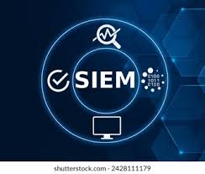

Our services encompass a range of products and consulting activities aimed at preventing money laundering and fraud, ensuring the successful implementation of a comprehensive Financial Crime Prevention Framework.
Orchestration, Automation, and Response
Information and Event Management
Fraud and crime prevention
Our services encompass a range of products and consulting activities aimed at preventing money laundering and fraud, ensuring the successful implementation of a comprehensive Financial Crime Prevention Framework.
SOAR platforms enable organizations to automate and orchestrate operations, enhancing incident response capabilities and reducing mean time to resolution (MTTR).
Incident Detection and Triage
Automated Response Workflows
Playbook Development
SIEM solutions provide real-time visibility into your organization’s safety posture by aggregating and analyzing security event data from across your IT environment. Nextech Solutions offers SIEM solutions that centralize event logging, correlation, and analysis, enabling proactive threat detection and response.
Log Collection and Aggregation
Threat Detection and Correlation
Incident Response and Reporting

Slide 42

DEVOPS page
Continuous Integration of All Processes. Advancing Through Code and Culture
At Nextech, we support organizations globally in enhancing their DevOps capabilities. We ideate, architect, develop, test, safeguard, and automate the software development process, creating custom industry-specific solutions that delight customers and drive intelligent enterprises. For years, we have been leaders in Global Nearshore software engineering services, helping our clients worldwide build and evolve reliable software solutions to continuously deliver value.

Slide 43
Excellence, Agility, and Scalable Automation
Nextech's DevOps practice offers the strategy, consulting, and coaching services essential for enterprise transformation. We foster an agile culture and establish processes that sustain high-performing teams focused on quality engineering.
Deliver with confidence. Achieve continuous value across the entire enterprise and enhance delivery capabilities.
Dramatically shorten the time to market for new digital initiatives.
Reach new maturity levels with automated tools and practices.
Boost production speed and code quality through automated testing and quality assurance
Our DevOps approach is built on a foundation of culture. By incorporating agile DevOps practices in every project, we aim to align our people, processes, and automation, ensuring quality and speed in our enterprise software solutions. We streamline development by breaking down silos, implementing automation, and expanding toolchains, leading to enhanced collaboration, maturity, and performance. As a trusted technology partner, Nextech can either complement your existing DevOps team or manage the DevOps practice as your continuous evolution partner.
Talk to our DevOps Team

Slide 44



Services
DevOps Consulting and Strategy
Infrastructure as Code (IaC)
Security Integration (DevSecOps)
Nextech empowers organizations to embrace Infrastructure as Code (IaC) for streamlined and automated infrastructure management. Our experts help you transition from manual provisioning to codified infrastructure, using tools like Terraform, Ansible, and CloudFormation. We assist in defining and managing your infrastructure through code, enabling version control, repeatability, and faster deployments. By implementing IaC, Nextech helps you reduce errors, improve consistency across environments, and achieve greater agility in responding to changing business needs. This results in efficient resource utilization, reduced costs, and a more robust and scalable infrastructure
Nextech's DevOps Consulting and Strategy services offer a tailored approach to accelerate your software delivery. We begin with a thorough assessment of your current processes, pinpointing bottlenecks and areas for improvement. Our experts then collaborate with your teams to craft a customized DevOps roadmap, outlining a phased transformation. This includes defining key metrics, selecting the right tools, and establishing a strategy for cultural change. Ultimately, Nextech empowers your teams to achieve faster releases, higher quality, and greater business agility.
Nextech integrates security seamlessly into your development lifecycle with DevSecOps practices. We automate security testing and analysis within your CI/CD pipeline, identifying vulnerabilities early and preventing costly breaches. Our approach includes robust vulnerability management to proactively address security risks in both applications and infrastructure. By "shifting left" and embedding security throughout the development process, Nextech helps you build secure and resilient systems.

Slide 45


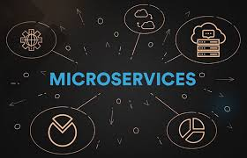
Cloud Services and Migration
Monitoring and Logging
Microservices
Nextech's Cloud Services and Migration expertise helps businesses seamlessly transition to and thrive in the cloud. We offer comprehensive cloud migration services, moving your applications and infrastructure to leading platforms like AWS, Azure, and GCP. Our team also specializes in cloud-native development, building modern, scalable applications using containers and serverless technologies. Finally, we provide cloud optimization services to ensure cost-efficiency and peak performance of your cloud environment.
Nextech's Monitoring and Logging services provide comprehensive visibility into your application and infrastructure performance. We implement leading monitoring tools like Prometheus, Grafana, and the ELK stack to track key metrics and provide real-time insights. Our expertise extends to log management and analysis, centralizing logs for efficient troubleshooting, identifying potential issues proactively, and ultimately improving system reliability and uptime.
Break free from the constraints of monolithic legacy systems by migrating to independently scalable and decentralized microservices. This modern approach enables rapid development of new features without the cumbersome, costly, and time-consuming processes associated with monolithic architectures.

Slide 46
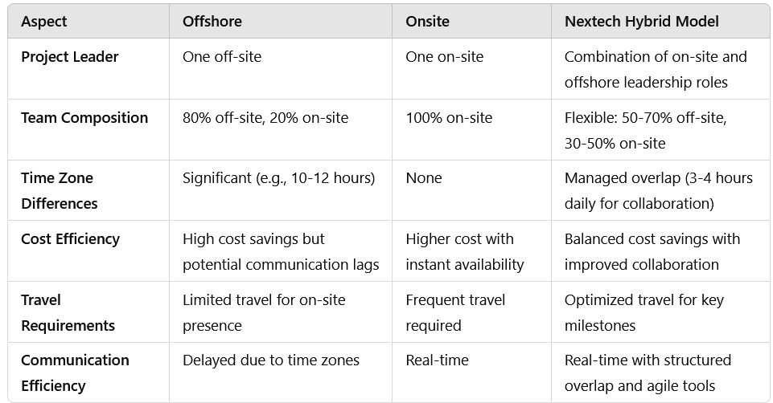
Leverage Proximity
As an initial step, the concept behind Nextech’s Offshore model was to address the challenges left by traditional on-site-only service delivery. This approach continues to be a key differentiator for Nextech, forming the foundation of our global services strategy.
The proximity component of the Offshore value proposition includes the following:
Cost Optimization: Leverage offshore resources to significantly reduce operational expenses.
Scalability: Quickly ramp up or scale down teams based on project demands with offshore flexibility.
Time Zone Advantage: Utilize time zone differences for continuous productivity, ensuring round-the-clock delivery.
Collaborative Tools: Employ advanced communication platforms to maintain seamless collaboration between on-site and offshore teams.
Expertise Accessibility: Gain access to a broad pool of specialized talent located offshore, providing diverse technical capabilities.

Slide 47

DATA AND AI
Accelerating Progress with Data and Artificial Intelligence
Building a modern digital enterprise is a transformative journey, with data at its core. Nextech’s expertise in data management, analytics, and AI enables organizations to unlock continuous business value and actionable insights across their operations. Guided by our Framework for Intelligent Digital Automation, our Data and AI practice is trusted globally to revolutionize operational models, enhance user experiences, and drive impactful transformation.
Talk to US

Slide 48




A Pioneering Strategy for Outstanding Outcomes
Revenue Growth and Profit Growth
Accelerate revenue growth through customer-focused experiences and data-driven strategies.
CX Transformations
At Nextech, we recognize the transformative power of data and AI to drive innovation and success across industries. Our cutting-edge services enable organizations to redefine customer experiences, boost productivity, fuel growth, and uncover new revenue opportunities.
With years of industry experience and a deep understanding of the rapidly evolving data and AI landscape, Nextech is the trusted partner for enterprises embarking on their digital transformation journeys.
Together, we can harness the full potential of data and AI, propelling your business to achieve unprecedented success in the digital era.
Transform customer experiences with data-driven insights, tailored personalization, and effortless interactions
Risk Mitigation and Fraud Detection
Cost Management
Protect your business with analytics-driven risk management and proactive fraud prevention
Achieve smarter cost optimization with analytics-driven insights and streamlined resource management.
Consult with Data & AI specialist

Slide 49



Data and Information services
Data Management Services
Data Analytics Services
AI and Machine Learning Services
Efficient data management is the foundation of any modern digital enterprise. Our Data Management Services ensure your organization's data is accurate, secure, and accessible, enabling informed decision-making and operational excellence. From data integration and migration to master data management (MDM) and data governance, we provide end-to-end solutions to organize, protect, and optimize your data. Whether modernizing legacy systems or implementing real-time data strategies, we help you unlock the full potential of your data to drive business growth and innovation.
Unlock the power of your data with Nextech's Data Analytics Services. From analyzing historical trends to forecasting future outcomes, our solutions include descriptive, predictive, and prescriptive analytics tailored to your business needs. With real-time analytics and interactive dashboards, we deliver actionable insights that drive smarter decisions and boost operational efficiency. Let us help you turn data into your competitive advantage.
Harness the power of AI and machine learning to transform your business. We specialize in developing custom AI models, natural language processing (NLP) for intelligent text and speech analysis, and computer vision solutions for image recognition. Our services also include building recommendation systems to personalize user experiences and drive better decision-making through predictive analytics. Unlock new opportunities with cutting-edge AI solutions tailored to your needs..

Slide 50



Data Warehousing
AI and Machine Learning Services
Cloud Services
A data warehouse is a centralized repository that consolidates structured data from various sources, enabling businesses to store, analyze, and retrieve large volumes of information efficiently. It supports decision-making by providing a single source of truth, optimized for complex queries and reporting. With scalable cloud-based solutions like Snowflake, Databricks, and Redshift, modern data warehouses empower organizations to gain actionable insights and drive strategic growth.
Leverage the power of AI to transform your business. We specialize in developing tailored AI and machine learning solutions, including predictive analytics, natural language processing (NLP), computer vision, and recommendation systems. Our services empower businesses to unlock actionable insights, automate processes, and enhance decision-making for measurable impact.
Transform your business with Nex tech’s end-to-end cloud solutions. Our offerings include cloud migration, data storage and management, and cloud-native application development. We specialize in deploying hybrid and multi-cloud environments, leveraging platforms like AWS, Azure, and GCP to deliver scalability, agility, and cost efficiency. From DevOps automation to cloud security, our expert team ensures seamless integration and optimized performance to meet your business needs.

Slide 51

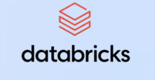



Slide 52
Artificial Intelligence
With a large, multi-disciplinary team specializing in Artificial Intelligence, Machine Learning, and Neural Networks, Nextech Enterprise USA delivers cutting-edge innovation and an unparalleled environment for creativity to help clients harness AI in transformative ways.
Combine the power of data and AI to scale and empower your enterprise.
Streamline business and IT processes through practical, design-driven automation.
Automate routine tasks and shape the future of augmented work.
Leverage a tool-agnostic approach to AI development, utilizing proven platforms and best practices.
Nextech ensures your organization remains at the forefront of AI-powered innovation.
Leveraging AI to Drive Enterprise Transformation
The potential of Artificial Intelligence to transform how we work, play, learn, shop, travel, and manage our health and finances is boundless. At Nextech, we adopt a tool-agnostic approach to implementing business and IT process automation, ensuring seamless service delivery that drives maximum benefits. Our focus is on delivering immediate, measurable results while aligning with your long-term vision. By anticipating customer needs and integrating forward-looking solutions, we empower you to achieve your organizational ambitions.
From automation to advanced analytics, Nextech enables global enterprises to confidently embrace AI-driven operating models across their business operations, processes, and product lines. Our expertise equips clients with the tools to enhance customer experiences, boost productivity, and drive profitability through successful AI implementations.
Consult with AI Expert

Slide 53



AI Strategy & Consultation
Custom AI Solutions Development
Machine Learning & Neural Networks
Nextech Enterprise USA empowers businesses to unlock the full potential of Artificial Intelligence with tailored strategies designed to align with their unique goals. Our experts assess AI readiness, identify high-impact opportunities, and develop actionable roadmaps that maximize ROI. By combining industry insights with cutting-edge technologies, we help organizations seamlessly integrate AI into their operations, driving innovation, efficiency, and growth..
Nextech Enterprise USA specializes in creating tailored AI solutions designed to address specific business challenges and unlock new opportunities. By leveraging cutting-edge technologies like machine learning, deep learning, and generative AI, we build scalable, end-to-end applications that drive efficiency, enhance decision-making, and deliver measurable results. Our custom solutions are designed with a tool-agnostic approach, ensuring seamless integration into your existing systems while maximizing ROI.
Nextech Enterprise USA specializes in Machine Learning and Neural Networks, leveraging advanced algorithms to empower businesses with predictive insights and intelligent automation. From building custom models to implementing deep learning techniques for image, text, and speech recognition, our solutions drive efficiency, enhance decision-making, and unlock new opportunities across industries

Slide 54



Data Engineering & Management
AI Governance & Ethical AI
Data Engineering & Management
Nextech Enterprise USA leverages cutting-edge AI technologies to automate repetitive tasks and streamline workflows, enhancing operational efficiency and reducing costs. By integrating intelligent automation solutions, we empower businesses to optimize processes, improve accuracy, and focus on strategic, high-value activities. From robotic process automation (RPA) to intelligent workflows, Nextech enables the future of augmented work, driving innovation and productivity across industries.
Nextech Enterprise USA ensures responsible and transparent AI adoption by establishing robust governance frameworks. We focus on ethical AI practices, prioritizing fairness, accountability, and compliance with global standards. Our solutions are designed to mitigate biases, safeguard data privacy, and align with your organization's values, enabling trust and reliability in every AI application. With Nextech, you can confidently innovate while upholding the highest ethical standards.
Nextech Enterprise USA specializes in building robust data pipelines and architectures to support scalable AI solutions. Our services include data integration, curation, and preparation, ensuring that your data is clean, consistent, and ready for advanced analytics. By leveraging the latest technologies, we empower businesses to unlock actionable insights and drive smarter decision-making

Slide 55

AI Agent Solutions
Revolutionize your business with intelligent, autonomous AI agents designed to drive efficiency, enhance decision-making, and deliver exceptional user experiences.

